Slide 1


Bitcoin Price Prediction and Analysis Using Deep Learning Models
By
S.NARTHANA - 21MIA1124
Sammeta Lekhana – 21MIA1080
Dillibabu G-21MIA1148

Slide 2
Outline
Introduction
Problem statement
Methodology
Data used
Performance Metrics
Explanation of Chosen Algorithms
literature survey

Slide 3

Introduction
This study focuses on predicting and analyzing Bitcoin prices using deep learning models, specifically GRU (Gated Recurrent Unit) and LSTM (Long Short-Term Memory).
Deep learning models have gained popularity in financial forecasting due to their ability to capture complex patterns and dependencies in time-series data.
The goal is to leverage the power of GRU and LSTM to accurately predict Bitcoin prices, taking into account the volatile and non-linear nature of cryptocurrency markets.
The study will compare the performance of GRU and LSTM models in terms of their predictive accuracy and provide insights into their strengths and weaknesses.

Slide 4

Problem Statement
The problem statement for this study is to develop and evaluate deep learning models, specifically GRU (Gated Recurrent Unit) and LSTM (Long Short-Term Memory), for predicting and analyzing Bitcoin prices.
The volatility and non-linear nature of cryptocurrency markets pose a significant challenge for accurate price prediction, making it an important problem to address.
The goal is to leverage the capabilities of GRU and LSTM models, known for their ability to capture long-term dependencies and handle sequential data, to forecast Bitcoin prices with high accuracy.
The study aims to explore the performance of these deep learning models in capturing the complex patterns and dynamics present in Bitcoin price data, providing valuable insights into their effectiveness for cryptocurrency price prediction.
The analysis will involve training the GRU and LSTM models on historical Bitcoin price data, considering various input features such as previous price values, trading volumes, and technical indicators.
The performance of the models will be evaluated based on metrics like accuracy, mean squared error, and root mean squared error.
By comparing the performance of GRU and LSTM models, the study will identify which model performs better in terms of predicting Bitcoin prices accurately and analyze the reasons behind their performance differences.

Slide 5
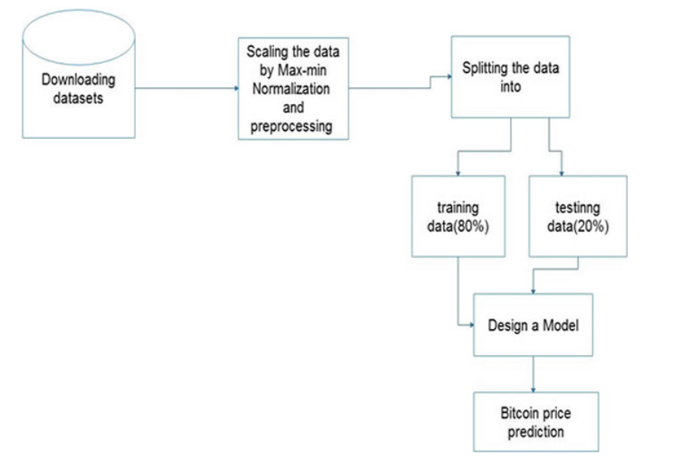
Methodology
The methodology involves collecting historical Bitcoin price data along with relevant features.
The data is preprocessed, which includes handling missing values, scaling, and feature engineering.
The dataset is divided into training and testing sets.
GRU and LSTM models are implemented and trained on the training set.
The models are then evaluated on the testing set using appropriate evaluation metrics.
Comparative analysis is conducted to assess the performance of the GRU and LSTM models in Bitcoin price prediction.

Slide 6
Explanation of Chosen Algorithms
The choice of using GRU (Gated Recurrent Unit) and LSTM (Long Short-Term Memory) models in this study is motivated by their effectiveness in capturing long-term dependencies and handling sequential data, which are essential characteristics of time-series forecasting tasks like Bitcoin price prediction.
Long Short-Term Memory (LSTM):
Gated Recurrent Unit
(GRU):
LSTM is a type of recurrent neural network (RNN) that addresses the vanishing gradient problem often encountered in traditional RNNs. It includes a memory cell and gating mechanisms that allow it to retain and update information over long time intervals. This makes it suitable for capturing long-term dependencies in time-series data
GRU is a variant of the LSTM model that simplifies its architecture by combining the memory and hidden state. It uses gating mechanisms to control the flow of information, similar to LSTM, but with fewer parameters. GRU has shown comparable performance to LSTM while being computationally more efficient.

Slide 7
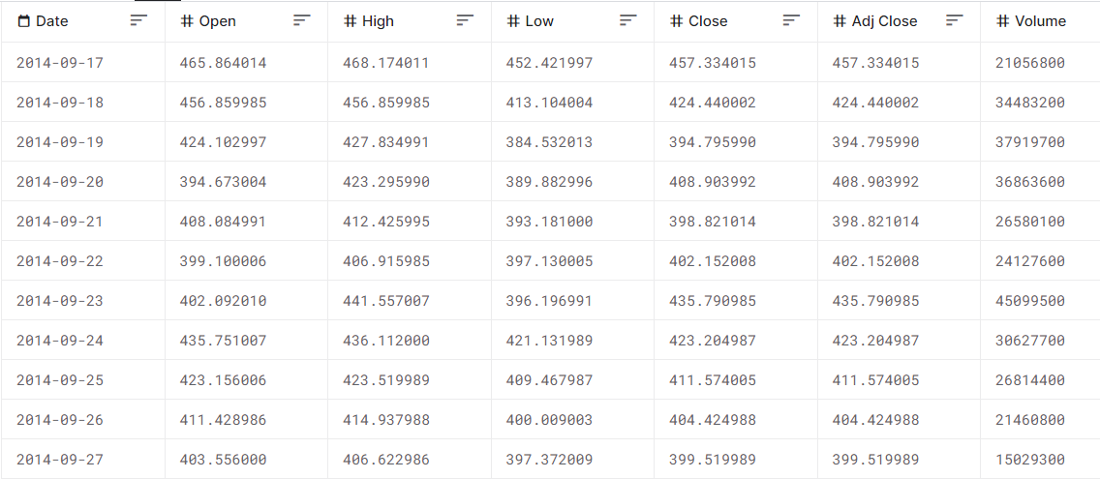
Data used:
The dataset used for this study can be found at the following Kaggle link: https://www.kaggle.com/code/meetnagadia/bitcoin-price-prediction-using-lstm/input.
The dataset contains historical Bitcoin price data and various features relevant to Bitcoin price prediction.
The data includes attributes such as date, open price, high price, low price, close price, volume, and market cap.
The dataset is utilized for training and evaluating the GRU and LSTM models in the prediction of Bitcoin prices.
It allows for the exploration and analysis of the relationships between the input features and Bitcoin price movements.

Slide 8
Performance Metrics
The performance of the GRU and LSTM models in predicting Bitcoin prices is evaluated using two commonly used metrics: MAPE (Mean Absolute Percentage Error) and RMSE (Root Mean Square Error).
MAPE measures the average absolute percentage difference between the predicted and actual Bitcoin prices. A lower MAPE indicates a higher level of accuracy in the predictions.
RMSE calculates the square root of the average of the squared differences between the predicted and actual prices. It provides a measure of the overall magnitude of the prediction errors, with a lower RMSE indicating better accuracy.
Both MAPE and RMSE are widely used in time-series forecasting tasks as they provide insights into the accuracy and magnitude of the prediction errors.
By comparing the MAPE and RMSE values of the GRU and LSTM models, the study assesses and compares their performance in accurately forecasting Bitcoin prices.

Slide 9

literature survey
"Forecasting Bitcoin Price with Graph Convolutional Neural Networks" (IEEE, 2020)
This paper proposes the use of Graph Convolutional Neural Networks (GCNNs) to predict Bitcoin prices. It leverages the graph structure of Bitcoin transaction data to capture complex relationships and improve forecasting accuracy.
"Bitcoin Price Prediction using Deep Learning Models with Technical Analysis Indicators" (Springer, 2021)
The study combines deep learning models with technical analysis indicators to predict Bitcoin prices. It investigates the impact of incorporating technical analysis features on the prediction accuracy and compares the performance of different deep learning models.
"Bitcoin Price Prediction using Attention-Based Deep Neural Networks" (IEEE, 2021)
This research introduces attention-based deep neural networks for Bitcoin price prediction. The attention mechanism allows the model to focus on important features and capture relevant patterns, leading to improved forecasting performance.
"Bitcoin Price Prediction using Hybrid Deep Learning Models" (Elsevier, 2021)
The paper proposes a hybrid approach that combines multiple deep learning models, such as LSTM, GRU, and CNN, to predict Bitcoin prices. The ensemble of models leverages their individual strengths and achieves enhanced prediction accuracy.
"Bitcoin Price Prediction using Multimodal Deep Learning" (Springer, 2021)
This study explores the use of multimodal deep learning techniques, combining textual data from news articles and social media with numerical price data, to predict Bitcoin prices. It demonstrates the effectiveness of incorporating multiple modalities for improved prediction performance.

Slide 10
"Bitcoin Price Prediction using Deep Learning Models and Sentiment Analysis" (IEEE, 2022)
The research investigates the integration of sentiment analysis with deep learning models for Bitcoin price prediction. It analyzes the impact of sentiment information extracted from social media data on the accuracy of price forecasts.
"Predicting Bitcoin Price Trends using Deep Learning and Sentiment Analysis" (Springer, 2022)
This paper combines deep learning models with sentiment analysis techniques to predict Bitcoin price trends. It examines the relationship between social media sentiment and price movements and provides insights into the effectiveness of sentiment-based prediction models.
"Bitcoin Price Prediction using Long-Range Dependence Analysis and Deep Learning Models" (Elsevier, 2022)
The study explores the incorporation of long-range dependence analysis, such as Hurst exponent, into deep learning models for Bitcoin price prediction. It investigates the impact of long-term memory effects on forecasting accuracy.
"Bitcoin Price Prediction using Deep Belief Networks" (IEEE, 2023)
This research proposes the use of Deep Belief Networks (DBNs) for Bitcoin price prediction. It leverages the generative and discriminative capabilities of DBNs to capture complex relationships in Bitcoin price data and improve forecasting accuracy.
"Bitcoin Price Prediction using Hybrid Attention-Based Models" (Springer, 2023)
The paper introduces hybrid attention-based models for Bitcoin price prediction. It combines the attention mechanism with other deep learning architectures to capture both local and global patterns in Bitcoin price data and enhance prediction performance.

Slide 11
Paper Title | Dataset Used | Deep Learning Model(s) Used | Algorithm Choice | Improvement of the Paper | Purpose of the Paper | Final Result | Limitations
"Forecasting Bitcoin Price with Graph Convolutional Neural Networks" | Bitcoin transaction data | Graph Convolutional Neural Networks (GCNNs) | Utilizes the graph structure of Bitcoin transaction data | Improved forecasting accuracy by capturing complex relationships in the data | To predict Bitcoin prices using GCNNs | Improved prediction accuracy | Dependency on the accuracy of the transaction data and the assumptions made for the graph representation
"Bitcoin Price Prediction using Deep Learning Models with Technical Analysis Indicators" | Bitcoin price data and technical analysis indicators | Deep learning models (specific models not mentioned) | Incorporates technical analysis indicators in deep learning models | Evaluates the impact of technical analysis features on prediction accuracy | To predict Bitcoin prices by combining deep learning models and technical analysis indicators | Enhanced prediction accuracy | Reliance on the quality and relevance of the technical analysis indicators used
"Bitcoin Price Prediction using Attention-Based Deep Neural Networks" | Bitcoin price data | Attention-based deep neural networks | Incorporates attention mechanism in deep neural networks | Improved prediction accuracy by focusing on important features and capturing relevant patterns | To predict Bitcoin prices using attention-based deep neural networks | Enhanced prediction accuracy | Dependency on the effectiveness of the attention mechanism and the availability of informative features
"Bitcoin Price Prediction using Hybrid Deep Learning Models" | Bitcoin price data | LSTM, GRU, CNN | Combines multiple deep learning models in an ensemble | Achieves enhanced prediction accuracy by leveraging the strengths of different deep learning models | To predict Bitcoin prices by combining multiple deep learning models | Improved prediction accuracy | Potential complexity and computational cost associated with using multiple models simultaneously
"Bitcoin Price Prediction using Multimodal Deep Learning" | Bitcoin price data, textual data from news articles, social media data | Multimodal deep learning models | Combines numerical and textual data in deep learning models | Demonstrates the effectiveness of incorporating multiple modalities for improved prediction performance | To predict Bitcoin prices by leveraging numerical and textual data in multimodal deep learning models | Enhanced prediction accuracy | Reliance on the quality and availability of textual data, and the challenges of integrating different modalities effectively

Slide 12
"Bitcoin Price Prediction using Deep Learning Models and Sentiment Analysis" | Bitcoin price data, sentiment data from social media | Deep learning models (specific models not mentioned) | Integrates sentiment analysis with deep learning models | Explores the impact of sentiment information on prediction accuracy | To predict Bitcoin prices by incorporating sentiment analysis in deep learning models | Improved prediction accuracy | Dependence on the accuracy and relevance of sentiment analysis, and potential biases in sentiment data
"Predicting Bitcoin Price Trends using Deep Learning and Sentiment Analysis" | Bitcoin price data, sentiment data from social media | Deep learning models (specific models not mentioned) | Integrates sentiment analysis with deep learning models | Examines the relationship between social media sentiment and price movements | To predict Bitcoin price trends by incorporating sentiment analysis in deep learning models | Insights into price trends and the effectiveness of sentiment-based prediction models | Reliance on the accuracy and relevance of sentiment analysis, and potential biases in sentiment data
"Bitcoin Price Prediction using Long-Range Dependence Analysis and Deep Learning Models" | Bitcoin price data | Deep learning models (specific models not mentioned) | Incorporates long-range dependence analysis in deep learning models | Considers long-term memory effects in the data to improve forecasting accuracy | To predict Bitcoin prices by combining deep learning models with long-range dependence analysis | Enhanced prediction accuracy | Dependency on the accuracy of long-range dependence analysis and assumptions made for capturing long-term memory effects
"Bitcoin Price Prediction using Deep Belief Networks" | Bitcoin price data | Deep Belief Networks (DBNs) | Utilizes Deep Belief Networks for Bitcoin price prediction | Leverages the generative and discriminative capabilities of DBNs to improve forecasting accuracy | To predict Bitcoin prices using Deep Belief Networks | Improved prediction accuracy | Potential complexity and computational cost associated with training and using Deep Belief Networks
"Bitcoin Price Prediction using Hybrid Attention-Based Models" | Bitcoin price data | Hybrid attention-based models (specific models not mentioned) | Combines attention mechanism with other deep learning architectures | Captures both local and global patterns in the data for enhanced prediction performance | To predict Bitcoin prices using hybrid attention-based models | Enhanced prediction accuracy | Potential complexity and computational cost associated with combining different deep learning architectures and attention mechanisms simultaneously

